Slide 1
Development of Heavily Aluminized Solid Rocket Propellant
By:
Gaines Gibson
Ruby Gomez

Slide 2
Objectives
Daedalus Astronautics
Project Goals
Mixing
Testing Results & Analysis
Future Plans

Slide 3

Daedalus Astronautics
Student Organization at ASU
Extensive Propulsion Experience
Community involvement
Notes:
We are Daedalus, a student org that works on ASU’s campus. We develop anything rocket related. In the past year we have come in second on a drag race to 10,000 feet for the Science Channel, built a 15 foot tall two stage, completed extensive hybrid rocket engine testing, roll control testing, and tested hybrid rocket engine swirl injectors. In addition, we have had past experience in monopropellant rocket engines. Finally, Daedalus has had a lot of experience developing and testing solid rocket propellant. Daedalus also likes to pass on our knowledge, getting kids excited in STEM. This past year, one of our members went to ASM, the next level of AIAA, for his own outreach program.

Slide 4
Project Goals
  To develop a heavily aluminized propellant
  To characterize the new propellant
  To test propellant on conventional and multi-grid nozzles.
Notes:
Be sure to discuss the reasons for heavily aluminizing the propellant, like determining the effects of high aluminum content on the motor hardware. Because it is a fuel, it should be more effective the higher the aluminum content, provided there is enough oxidizer. Be sure to also explain what the MGN is, specifically.

Slide 5
Raytheon Propellant Formulation
Order | Material | Purpose / Component | Percentage | Calculated Weight (lb)
1 | HTPB | Binder | 8.5 | .64425
2 | Aluminum | Fuel | 19 | 1.425
3 | DOA | Plasticizer | 2 | .15
4 | HX-752 | Bonding Agent | .3 | .0225
5 | Tepanol | Bonding Agent | .5 | .0375
6 | Ammonium Perchlorate (AP) | Oxidizer | 69 | 5.175
7 | IPDI | Curative | .59 | .04425
N/A | TPB | N/A | .02 | -
Notes:
This was the original propellant we were given to work with, listed in the specific order that it was to be tested with. Raytheon provided this propellant formula. As you can see, the aluminum content is very high, as is the total content of the solids of the propellant. In fact, 85-90% of the propellant is in a solid form. This can be dangerous, because the propellant has a higher risk of dusting, and the KitchenAide have a higher risk of heating up. It is also a problem because the propellant would not harden completely, and even months later behaved as a plastic.

Slide 6
Daedalus Propellant
 | Original CrazyPants3 Formulation | CrazyPants3 Modification 1 | CrazyPants3 Modification 2
Chemical | Percentage | Percentage | Percentage
Ammonium Perchlorate (200 micron) | 73.8 | 72.3 | 70.96
HTPB | 14.2 | 13.9 | 13.65
Aluminum (325 mesh) | 5 | 7 | 9
Dioctyl Adipate | 3.55 | 3.48 | 3.41
Isonate 143L | 1.84 | 1.80 | 1.77
Iron Oxide | .55 | .54 | .529
Strontium Chromate | .30 | .29 | .288
Carbon Black | .20 | .196 | .192
Tepanol | .20 | .196 | .192
Castor Oil | .20 | .196 | .192
Copper Oxide | .15 | .147 | .144
Silicon Oil | .01 | .009 | .009
Notes:
This is the Daedalus developed propellant formulation. The original formula is on the far left. It was developed and believed to be characterized two years ago. The further right you go, the more aluminum has been added to the propellant, which was then normalized. If you notice, the solid content isa little lower, however the additives make this propellant very difficult to control. For example, Strontium Chromate is an intensely powerful oxidizer. And Ferric and Copper Oxide both make thermite reactions with the aluminum fuel.

Slide 7

Test One
Summary
Failure Analysis
Original CP-3 Propellant
Result: Catastrophic over-pressurization
Root cause analysis found failure due to nozzle throat area
Extremely aggressive propellant burn
Notes:
To begin with, we never fired the Raytheon propellant in a motor casing. It was deemed too unstable after watching it burn at atmospheric pressure. It also was so soft there was a legitimate fear that it would collapse due to the pressure.
Extremely high Kn value at ignition: >270 (Area of burning surface/Area of nozzle). CP-3’s extraordinarily fast regression rate led to a rapid over pressurization to 1500 psi. Normal Failure does not involve shrapnel, but rather chunking the nozzle.
Left Image) The test stand post-test fire. Note wreckage around the base and the fact that the motor casing blow off the sides of the threaded end cap.

Slide 8
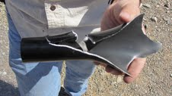
Test Two
Summary
Failure Analysis
7% CP-3 Propellant
Result: Catastrophic over-pressurization
60 lb thrust at operating pressure
Root cause was extremely fast regression rate
Exact same hoop stress failure as first test
Notes:
1) Don’t forget to note on test 2 that the operating pressure was experimentally determined to be 1000 psi two years ago, when the propellant was thought to have been characterized. We agreed to go ahead with aluminizing the propellant when we determined that it was operator error one test 1.
2)Test 2’s failure arose from the propellant. We changed the nozzle size from .2” diameter to .4” diameter. Even using BurnSim, usually accurate to within 5%, with the accepted and researched values predicted that the test would be successful.
3) Right Image) The location of the hoop stress failure of the motor casing at 1500 psi.

Slide 9
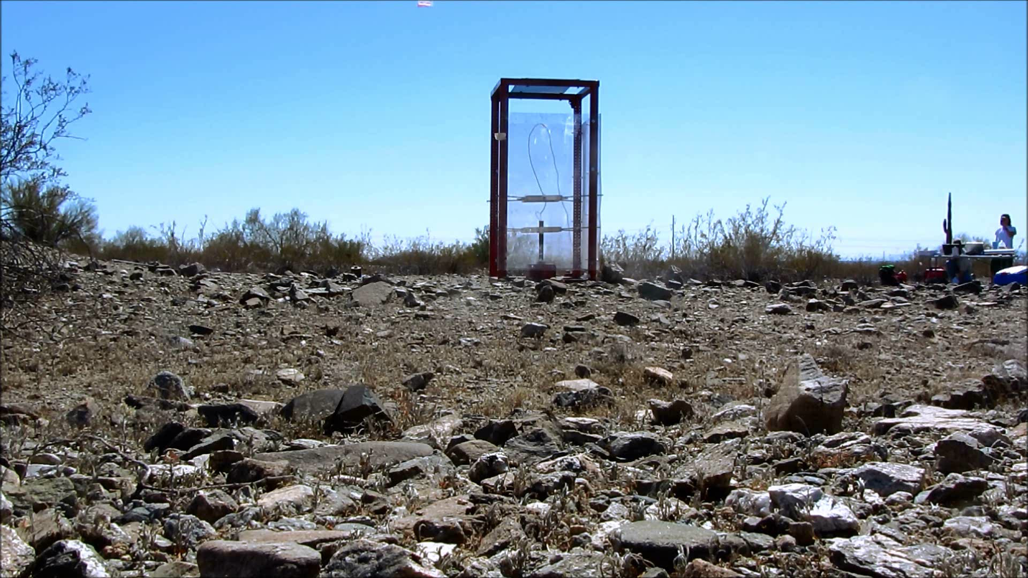
Test Two: Actual Time

Slide 10

Test Two: ¼ Speed

Slide 11
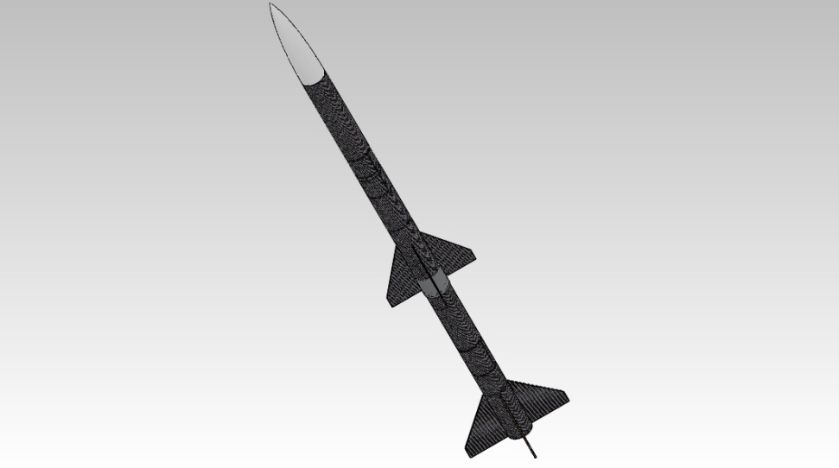
Future Efforts
Complete All Project Goals
Develop another propellant for custom rockets
Rocket for ESRA Basic Competition Summer 2012
Notes:
We intend to complete all the listed goals at the beginning of the presentation; however, due to the failures we have no more materials to continue testing and are waiting to be resupplied before testing can be completed. Also, Daedalus is looking into change from Tepanol to HX-752; a material that performs the same function as Tepanol without the ammonia production. It has proven difficult to find.
ESRA II will be using the SRM research to fly at Intercollegiate Rocketry Competition.

Slide 12
A Special Thanks To:
Raytheon Missile Systems
NASA/Space Grant
Arizona State University
Matthew Summers

Slide 13
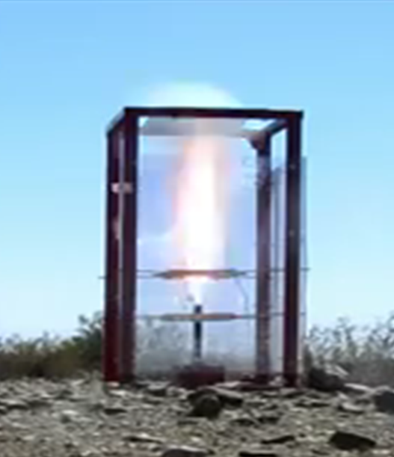
Questions?
Notes:
For the image, explain that the motor casing is approximately 12” long. Therefore, the plume is approximate 48” long. The small white cloud might be the air condensing from the thrust. Example of the power of CP-3.

